Slide 1
Utah’s Budget, FY 2024-2025

Slide 2
Utah’s Budget, FY 2024-2025
Overview
General and Income Tax (GF/ITF) Revenue
GF/ITF Budget Priorities
Special Funding Sources - ARPA
Long-Term Fiscal Health
Budget Process Changes

Slide 3
All Sources - $29.4 billion

Slide 4
General and Income Tax Funds
*Including reallocations and after tax cuts

Slide 5
GF/ITF Revenue
Part 2

Slide 6
GF/ITF Revenue
Revenue Estimates*
Available GF/ITF Revenue
FY 2024
  GF $4.2 billion
  ITF $7.3 billion
  Total $11.5 billion
FY 2025
  GF $4.2 billion
  ITF $7.4 billion
  Total $11.6 billion
Ongoing $630 million
  (including $150 m high-risk revenue)
One-time $340 million
  (including $99 m food sales tax phase-out)
$1.9 billion reductions and reallocations
*Incl. high risk revenue

Slide 7
Internal Reallocations
$1.1 billion from debt service to cash-funded infrastructure
$521 million from the Public Education Stabilization Account
$120 million from Medicaid savings
$51 million in interest on ARPA deposits
$170 million restricted account balances and other

Slide 8
Tax Reductions - $228 million
$168 million ongoing and $37 million one-time for income tax rate change (4.65% to 4.55%)
$2.3 million ongoing beginning in 2026 for expanded child tax credit eligibility
$1 million ongoing and $22 million one-time to reauthorize rural film incentives

Slide 9
GF/ITF Funding Priorities
Part 3

Slide 10
State Agency and Higher Education
Compensation
$119.3 million from all sources (including $76.1 million GF/ITF) for a 3% general salary increase in state agencies and higher education
$19.1 million from the General and Income Tax Funds for performance‐based salary increases for state agency employees
$14.1 million from all sources (including $13.4 million GF/ITF) for a 7.2 percent health insurance increase and 0.9 percent dental insurance increase in state agencies
Other Increases:
  $3.2 million for a 0.7% COLA for employees on Tier II retirement
  $1.5 million for Utah Schools for the Deaf and the Blind
  $5.7 million one‐time for 401k matching; and
  $2.5 million for public safety/firefighter retirement enhancements.

Slide 11
Education
$211.7 million ongoing for a 5% increase in the value of the WPU (from $4,280 to $4,494)
$521.0 million one-time from the Public Education Stabilization Account, including:
  $150.0 million for Excellence in Education and Leadership
  $101.2 million for K-12 School Property Insurance
  $100.0 million for School Safety
  $74.0 million for Educator Professional Time
  $35.5 million for School Fees Amendments
  $15.0 million for Small/Rural District Capital Needs (with another $15.0 from the USF)
  $8.4 million for Teacher Supplies
  $8.4 million for Stipends for Future Educators
$57.0 million for at-risk students and digital teaching tool
$40.0 million for Utah Fits All scholarships
$20.0 million for university performance funding
$6.7 million ongoing for growth and $5.0 million one-time for equipment at tech colleges
$2.7 million one-time to back-fill eliminated higher education application fees

Slide 12
Infrastructure
Transportation:
  $330.0 million ongoing and $775.0 million one for transportation infrastructure
  $50.0 million one-time for the Point of the Mountain transit stop
Higher Education:
  $0.7 million ongoing and $75.0 million one-time for the Huntsman Cancer Institute’s Vineyard Cancer Research and Academic Building
  $0.6 million ongoing and $64.9 million one-time for the Ogden-Weber Technical College’s Pathway Building;
  $0.5 million ongoing and $19.4 million one-time for Snow College’s Social Science Classroom and Laboratory Building
General Government:
  $10.0 million one-time for the Salt Lake City Veterans’ Home Construction
  $20.0 million one-time for a loan to replace the San Juan Hospital Building
  $100.0 million one-time for statewide master plan (contingent on sufficient revenue collections)

Slide 13
Homeless, Housing, and Social Services
$17.0 million one-time for $300 million in loans under the Utah Homes Investment Program
$3.0 million one-time for the Shared Equity Revolving Loan Program
$3.0 million one-time for the Law Enforcement First Time Homebuyers Program
$10.0 million ongoing and $11.8 million one-time for statewide homeless system support
$1.2 million one-time in FY 2024 and $23.8 million one-time in FY 2025 for low-barrier shelters
$2.5 million for Homeless Shelter Cities Mitigation
$10.4 million to provide services for youth with disabilities transitioning from programs for younger individuals
$5.0 million to provide services for individuals with disabilities on the waiting list for services

Slide 14
Criminal Justice and General Gov’t
$13.0 million ongoing for Corrections targeted compensation and $2.0 million ongoing to support Corrections officer overtime
$8.5 million one-time, plus $5.0 million one-time from the Wildlife Resources Restricted Account and $5.0 million one-time from the State Park Fees Restricted Account to purchase land for Wildlife Resources in Morgan County
$9.0 million one-time for Kane County Water District and Washington County Water Conservancy District to construct a reservoir
$5.3 million one-time for Rural Communities Opportunities Grants
$3.0 million one-time to purchase open space to protect the mission of Camp Williams

Slide 15
Special Funding Sources
Part 4

Slide 16
Remaining American Rescue Plan Act (ARPA) Funds
$5.0 million one-time for Ogden Canyon water line
$50 m Capital Projects Funds for middle-mile broadband at UDOT freeing-up General Fund for:
  $25 million for Wasatch Canyons Behavioral Health facility
  $12.5 million for UU Redwood Road Clinic
  $12.5 million for San Juan Hospital

Slide 17
Long-term Fiscal Health
Part 5

Slide 18
Careful Spending to Manage Risk
No new GO debt
$335 million increase in Transportation working rainy-day fund
$150 million ongoing from high-risk revenue for infrastructure
$7.5 m in ongoing revenue in excess of ongoing commitments

Slide 19
Formal Rainy-Day Funds

Slide 20
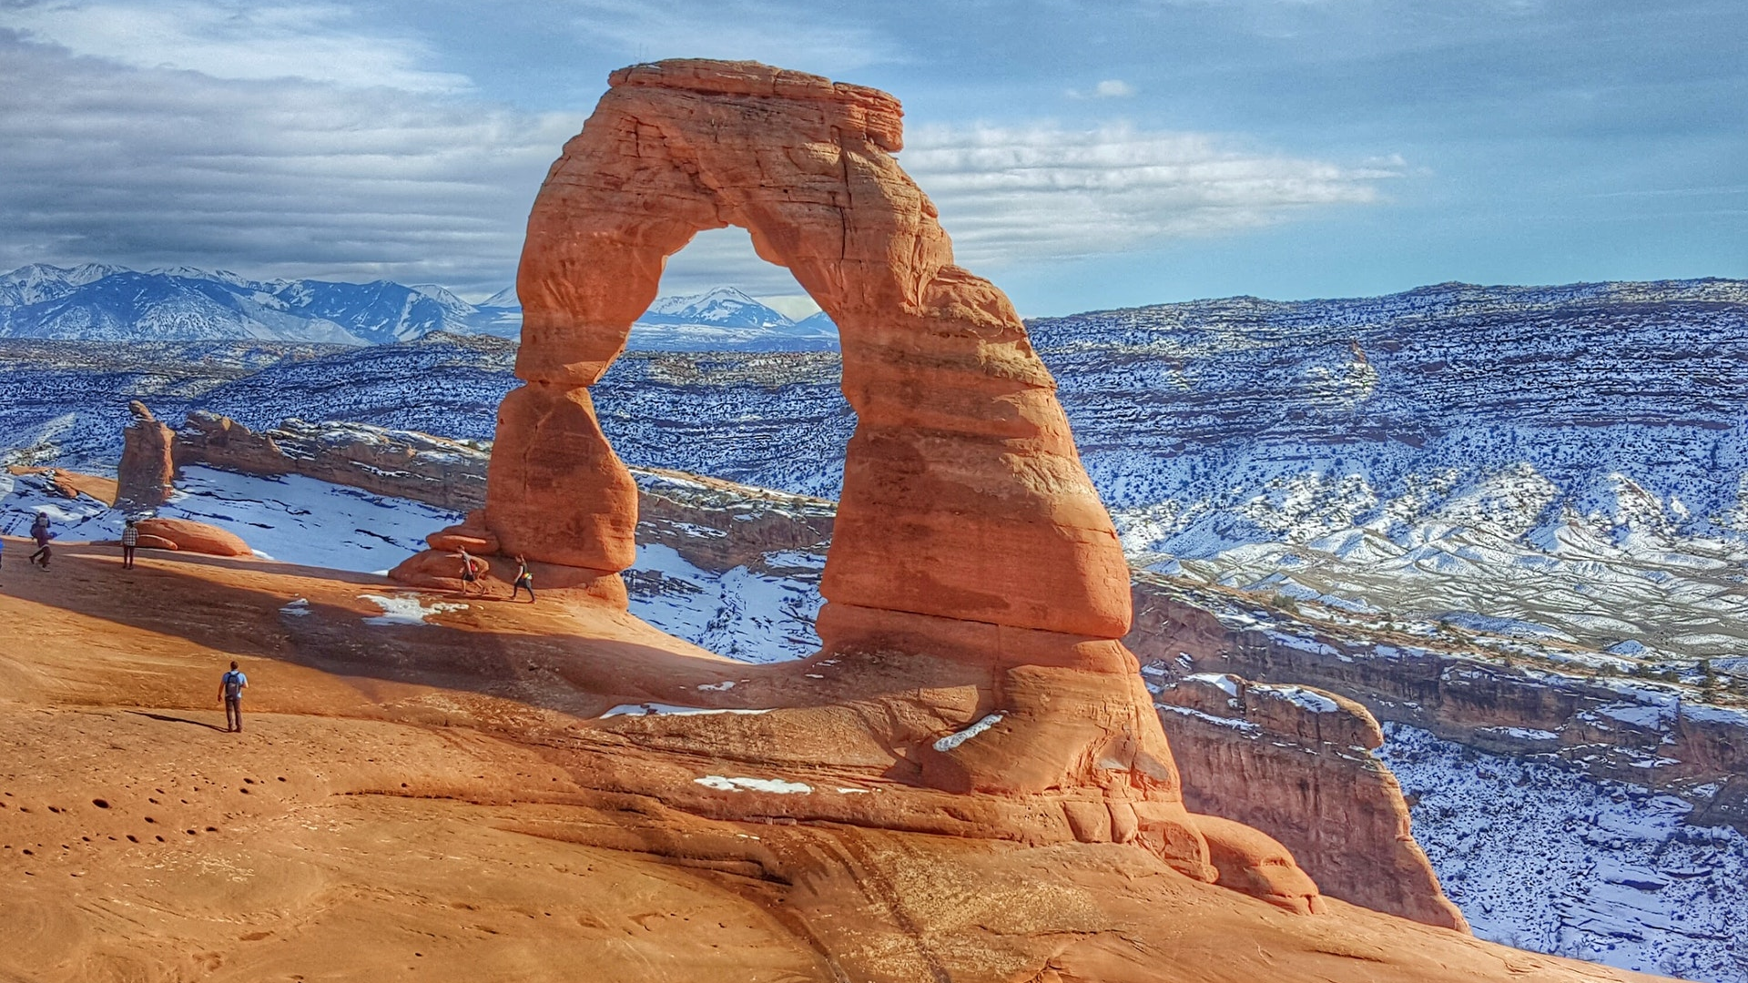
Utah
“#1 Best State Overall” -U.S. News and World Report
May 2024
20

Slide 21
Budget Process/Policy
Part 6

Slide 22
HB 51, HHS Funding Amendments
Requires LFA and GOPB to analyze risk associated with the Medicaid program as part of the budget stress test every three years and recommend budgetary actions
Merges two Medicaid restricted accounts and renames another

Slide 23
HB 59, Federal Funds Contingency Plans
Repeals federal funds receipt reports that required contingency plans for a 5% and 25% reduction and a compilation by Division of Finance
Requires a “Contingency disclosure and plan” and a “State jurisdiction evaluation” for qualifying federal funds (exceed 10% of an agency’s budget or $2M)
Also requires a “Federal funds contingency plan” for agencies with federal funds that exceed 33% of the total budget, every other year or for new requests over $10M and provide a copy to GOMB, LFA, and EAC

Slide 24
HB 335, State Grant Process
Requires that a grant recipient provide a proposed budget and agree to deliverables, reporting, audit, and clawback requirements before receiving any grant funds
Addresses the disbursement schedule for grant funds
Requires administering agencies to report a competitive grant to LFA and GOPB before awarding the grant
Requires direct award grants to state the recipient in intent language, repeated each year for ongoing appropriations

Slide 25
HB 532 and 534, Boards and Commissions
Follow up on HB 34, 2023 GS
Repeal or sunset over 50 boards and commissions
Raise barriers for creating more
Increase reporting requirements for boards to remain in place

Slide 26
SB 154, Independent Entities
Requires designated independent entities to use LAG’s best practices tools and provide the results to the Governor and a “consensus group” comprising LRGC, LFA, and LAG
Requires the consensus group to report findings to the Leg Management Committee, Leg Audit Subcommittee, and the Executive Appropriations Committee
Allows these committees to act based on the reports

Slide 27
SB 192, Higher Education Amendments
Requires higher education institutions to request O&M funding at the same time as they request legislative approval for dedicated or nondedicated projects
Beginning December 1, 2025, requires EAC to appropriate 6% of growth in personal income tax withholdings (calculated on a five-year average) into the Performance Funding Restricted Account

Slide 28
SB 241, State Funding Amendments
Repeals two restricted accounts
Modifies others to comply with GASB
Clarifies some accounts’ purposes
Approves revenue bonds of $400M for the UU’s West Valley Health Center
Allows DGO to transfer money appropriated to Division of Finance for Pay-for-Performance to other agencies
Allows Finance to transfer money from the Income Tax Fund to the Uniform School Fund to make up a deficit in the USF

Slide 29
HJR 17, Agency Fees
Requires an appropriations subcommittee to review agency fees during an accountable budget process and
Consider and make recommendations regarding:
  the methods the fee agency uses to determine the amount of each fee
  the agency's estimated cost related to each fee

Slide 30
HJR 23, Legislative Process
Renames certain joint appropriations subcommittees and adds a new joint appropriations subcommittee
  Infrastructure and Gen Govt -> Transportation and Infrastructure
  Business, Econ Devel, and Labor -> Economic and Community Devel
  New: General Government
Increases the threshold for fiscal note bills that are subject to a funding prioritization process and passage deadline from $15,000 to $20,000

Slide 31
SJR 15, Higher Education O&M
Requires the Executive Appropriations Committee each December to:
  hear a report on construction inflation and the operation and maintenance costs of certain higher education capital development projects
  decide whether to adjust the base budget or set aside an allocation to address the costs

Slide 32
Questions?

