Slide 1
Utah’s Budget, FY 2025-2026
Jonathan Ball
Legislative Fiscal Analyst
Executive Appropriations Committee, May 20, 2025

Slide 2
Utah’s Budget, FY 2025-2026
Overview
General and Income Tax Revenue
General and Income Tax Budget Priorities
Special Funding Sources
Long-Term Fiscal Health
Budget Process Changes

Slide 3
All Sources - $30. 8 Billion*
*Operating and Capital Budgets including Expendable Funds and Accounts.

Slide 4
State Funds - $11.8 Billion*
*All appropriation types including transfers between funds and accounts.

Slide 5
General and Income Tax Fund Revenue
Part 2

Slide 6
GF/ITF/USF Revenue Estimates
May 2025 (in Billions)* | FY25 | FY26
General Fund | $4.2 | $3.9
Income Tax Fund | $7.4 | $7.6
Total | $11.6 | $11.5
$88 million one-time and $324 million ongoing available in December after accounting for tax cuts
Base spending and set-asides brought available amounts to zero in December
Revenue declined $74 million one-time and $38 million ongoing in February
*Not including:
($0.002 billion) FY 2024 revenue deficit
($0.003 billion) per year econ dev incentives
$1.36 billion FY 2025 and $0.37 billion FY 2026 beginning balances
$0.06 billion FY 2025 appropriated transfers

Slide 7
Tax Cuts
$103.3 million ongoing and $22.6 million one-time for an income tax rate cut from 4.55 percent to 4.50 percent
$2.0 million for a new nonrefundable tax credit for childcare centers and $4.1 million for expansion of the nonrefundable child tax credit
$24.1 million ongoing and ($1.3 million) one-time for expansion of the Social Security Benefits Income Tax Credit
$16 million ongoing and ($13 million) one-time for single sales factor apportionment of financial institutions
$3.3 million ongoing and ($0.4 million) one-time for small remote seller sales tax relief

Slide 8
Reallocations and Reductions
$100 million in ongoing and one-time budget reductions identified by subcommittees
More than $100 million in additional cuts and reallocations added by EAC
Nearly 2% of General and Income Tax Funds budget, combined
$112 million in “high risk” revenue set-asides – enough to cover February revenue shortfall

Slide 9
General, Income Tax, and Other Funding Priorities
Part 3

Slide 10
K-12 and Higher Education
$178.6 million ongoing to increase WPU by 4.0 percent, from $4,494 in FY 2025 to $4,674 in FY 2026
$47.4 million ongoing and $45.2 million one-time for $1,000 teacher raises and support staff bonuses
$40 million ongoing for Utah Fits All scholarships
$94 million one-time for CTE programs including the Catalyst Program [$65.0 m] and First Credential for All [$29.0 m]
$20 million for higher education performance funding
$60.5 million in university strategic reinvestment reallocations

Slide 11
Law Enforcement and Social Services
$0.9 million one-time and $1.3 million ongoing to fund an additional 10 UHP troopers
$6.5 million one-time to support operations at the state prison
$0.95 million one-time and $0.8 million ongoing for fentanyl interdiction personnel and equipment
$82.0 million ongoing and ($85.2 million) one-time for Medicaid growth and inflation
$13.5 million ongoing and ($4.7 million) one-time for DSPD waiting list
$2.5 million to increase Medicaid nursing home reimbursement rates

Slide 12
Infrastructure & Economic Development
$118 million one-time and $3 million ongoing for state government buildings
$100.8 million one-time for various Higher Education buildings
Shift $330 million in GF transportation appropriations to earmarks
$1.8 million ongoing for highway carcass and litter removal
$20 million one-time for first-time home buyer incentives
$1.9 million ongoing for family shelter in Salt Lake County
$5.5 million one-time for winter and summer shelter
$3.5 million one-time from license plates for state museum

Slide 13
Natural Resources and Other
$50 million one-time plus $12 million ongoing from a restricted account to conserve land in Book Cliffs
$11.8 million one-time for Operation Gigawatt
$2 million ongoing for elections outreach
$2.2 million ongoing for mandatory private insurance costs
$2 million one-time for National Guard retention bonuses
$1.5 million one-time for National Guard tuition assistance

Slide 14
Employee Compensation
$66.8 million ongoing for a 2.5 percent compensation increase for state agency and higher education employees
$10.3 million one-time for performance‐based incentives and $1.6 million one-time for bonuses to various state employees
$10.6 million for a 5.0 percent health insurance increase and 6.9 percent dental insurance increase in state agencies
$5.2 million ongoing for compensation of Internal Service Fund employees (S.B. 256)
$1 million ongoing for a 2.5 % salary increase for state judges

Slide 15
Special Funding Sources
Part 4

Slide 16
Several Budget Buffers Used to Balance
($29.9 million) ongoing in GF deposits to Medicaid ACA Account
($80.7 million) one-time from Medicaid Stabilization Account
($60.0 million) ongoing and $53.0 million one-time for Higher Education capital development funding
($6.2 million) ongoing in Capital Improvements over 1.1% of replacement value
($63.2 million) one-time in FY 2026 and ($63.5 million) one-time in FY 2027 from Capital Improvements to Development
($3.4 million) ongoing and ($16.2 million) one-time from Tax Commission Administrative Expense Account

Slide 17
Long-term Fiscal Health
Part 5

Slide 18
Maintaining First Place in Fiscal Stability
Ongoing revenue exceeds ongoing commitments by $7.5 million
$145.2 million one-time deposited into formal rainy-day funds
$85 million one-time to eliminate a cash deficit in DABS funds
Pay-down $255.3 million in existing General Obligation debt
Authorized $70 million in new affordable housing G.O. debt
Created State Sovereignty Endowment Fund to counter long-term federal budget risk and unsustainability

Slide 19
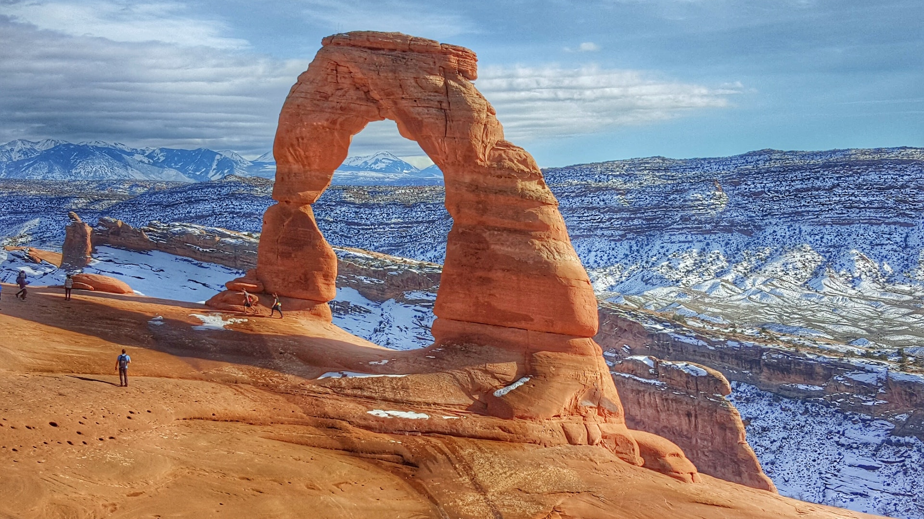
Yet Again…
#1 Best State Overall
#1 State for Fiscal Stability
U.S. News and World Report
May 2025
19

Slide 20
Budget Process/Policy
Part 6

Slide 21
H.B. 10 Fund and Account Modifications
Modifies the amount that the Division of Finance annually transfers from the Liquor Control Fund to the General Fund by adjusting for amounts needed for cash operations
Changes the Opioid Litigation Proceeds Restricted Account from a restricted account to a permanent fund called the Opioid Litigation Proceeds Fund
Establishes the State Treasurer Investment Management Account and provides for the account's uses

Slide 22
H.B. 67 Precious Metals Investment
Allows the state treasurer to deduct administrative costs for investing in precious metals, including delivery and vaulting costs, from earnings generated by the investments in the state’s rainy day funds

Slide 23
H.B. 223 State Grant Requirements
Upon a grantee's request, requires an administering agency to disclose the administering agency's costs associated with administering a grant

Slide 24
H.B. 239 Disaster Funds Revisions
Increases thresholds on uses of State Disaster Recovery Restricted Account and reporting requirements
If the balance in the State Disaster Recovery Restricted Account exceeds $50 million at the end of a fiscal year, requires a transfer of up to $10 million to the Disaster Response, Recovery, and Mitigation Restricted Account, up to a maximum of $50 million
Allows the Disaster Response, Recovery, and Mitigation Restricted Account to be used for pre-disaster mitigation in communities

Slide 25
H.B. 265 Higher Education
Requires each degree-granting institution to create a strategic reinvestment plan to reallocate funding from certain programs and divisions of the institution to certain programs and divisions in the same institution that merit additional investment
Authorizes the phasing out of reduced or eliminated programs or divisions of institutions over three fiscal years

Slide 26
H.B. 317 Executive Agency Innovations
Allows funds reviewed in the Efficiency Improvement Process (EIP) to be nonlapsing
Requires the EIP to address metrics, rewards, recognitions, and incentives
If an agency’s EIP results in cost savings, allows the agency to request a portion of the funds be made nonlapsing and use the funds for employee retention or employee performance incentives

Slide 27
H.B. 459 Appropriations Subcommittees
Throughout the code, changes subcommittee names and clarifies reporting requirements:
  "Business, Economic Development, and Labor Appropriations Subcommittee" to "Economic and Community Development Appropriations Subcommittee"
  "Executive Offices and Criminal Justice Appropriations Subcommittee" to "Criminal Justice Appropriations Subcommittee"
  "Infrastructure and General Government Appropriations Subcommittee" to "Transportation and Infrastructure Appropriations Subcommittee"

Slide 28
H.B. 464 State Sovereignty Fund
Establishes the State Sovereignty Fund, consisting of:
  Any reserve account surplus (portion of surplus after required deposits to General and Income Tax Fund Budget Reserve Accounts)
  Half of any General Fund savings from a decrease in the Federal Medical Assistance Percentages
  12.5% of state fund savings from any enhanced Federal Medical Assistance Percentage
  Any excess revenue collections (General Fund or Income Tax Fund revenue that exceeds the estimated revenue for that fiscal year by more than two standard deviations on a 20-year mean)
  Interest and legislative appropriations

Slide 29
H.B. 475 Public Funds Reporting
Directs the state auditor to annually prepare a report that states, for each entity that holds public funds, the entity's total balance of cash, cash equivalents, and investments

Slide 30
S.B. 256 General Gov’t Amendments
Implements General Government Appropriations Subcommittee Accountable Process Budget recommendations
Establishes a process for an internal service fund agency to compensate the agency's employees at a rate that is equivalent to state agency employees by submitting a proposed increased rate schedule to the rate committee after the annual legislative session

Slide 31
S.B. 283 Funds Amendments
Clarifies that an internal service fund agency may charge a rate that is less than the rate approved by the Legislature if they first report their justification for doing so
Prohibits a fee agency from charging a fee amount that is different from the amount the Legislature approved, unless the amount is less than the approved amount and the fee agency first reports their justification
If a fee agency charges a fee that is higher than approved by the Legislature, it must attempt to return the funds to the payors and any remaining amount must be transferred to the General Fund
Allows the State Tax Commission to use money in the State Tax Commission Administrative Charge Account to offset general operational expenses

Slide 32
Questions?

