Slide 1
Utah’s Budget, FY 2026-2027
Jonathan Ball & Steven Allred
Executive Appropriations Committee
May 19, 2026

Slide 2
Utah’s Budget, FY 2026-2027
Overview
General and Income Tax (GF/ITF) Revenue
GF/ITF Budget Priorities
Long-Term Fiscal Health
Budget Process Changes

Slide 3
All Sources - $31.6 Billion (-0.2% Y0Y)

Slide 4
Discretionary - $12.4 Billion (+2.3% YoY)

Slide 5
Budget Change Over Time

Slide 6
GF/ITF Revenue
Part 2

Slide 7
GF/ITF/USF Revenue Estimates
May 2026 (in Billions)* | FY26 | FY27
General Fund | $4.0 | $4.1
Income Tax Fund | $7.6 | $7.8
Total | $11.6 | $11.9
$184 million one-time and $362 million ongoing available in December after accounting for HR 1 (OBBBA) impacts
Base spending and set-asides brought available amounts to zero in December
February revenue rose $125 million one-time (1.1%) and $88 million ongoing (0.7%)
*Not including:
$0.27 billion FY 2025 budget surplus
($0.003 billion) per year econ dev incentives
$0.36 billion FY 2026 and $0.51 billion FY 2027 beginning fund balances
$0.09 billion FY 2026 and $0.02 billion FY 2027 appropriated transfers

Slide 8
Reductions and Reallocations
($173.9 million) ongoing and ($125.0) million one-time in reductions and funding sweeps
($298.9 million) in combined offsets equal to 2.6 percent of the $11.5 billion FY 2027 base budget
Reductions by subcommittee ranged from 1.0 in Public Education to 16.5 percent in Economic and Community Development
All offsets were reallocated to other higher priority spending items

Slide 9
Major Tax Changes
H.R. 1, “One Big Beautiful Bill Act” adjusted federal income tax provisions that impact Utah revenue. ($201.3 million) ongoing, ($313.8 m) one-time.
S.B. 60, “Income Tax Rate Amendments” reduced state income and corporate tax rates from 4.5 percent to 4.45 percent. ($101.0 million) ongoing, ($1.3 million) one-time in FY 2026 and ($22.0 million) one-time in FY 2027.
H.B. 190, “Child Care Business Credit” expanded tax credits to off-site childcare facilities and increased the amounts employers can claim. ($2.9 million) ongoing offset by $0.3 million one-time.
H.B. 290, “Child Tax Credit Amendments” expanded eligibility for the child tax credit by increasing income-based phase-out thresholds. ($7.1 million).
H.B. 337, “Nicotine Product Tax Amendments” increased taxes on cigarettes & other nicotine products. $17.1 million ongong offset by ($1.0 million) one-time.
H.B. 575, “Fuel Tax and Supply Amendments” reduced the state gas tax by 6 cents per gallon for six months. ($40.08 million) one-time.

Slide 10
GF/ITF Funding Highlights
Part 3

Slide 11
Law and Order
$125.0 million to support the design and construction of new prison space at the Central Utah Correctional Facility in Gunnison
$8.2 million ongoing and $4.3 million one-time for judicial reforms including additional judgeships, increased transparency, and creation of a Constitutional Court
$5.0 million in restricted funds to increase state highway patrol trooper levels to patrol increased state, federal highway roads, and lanes
$1.1 million for indigent appellate defense attorneys and grants to rural areas

Slide 12
Water
$30.0 million one-time from the Long-term Capital Projects Fund to purchase US Magnesium's property, including their roughly 144,000 acre-feet water right portfolio, for the benefit of the Great Salt Lake
$5.0 million one-time for litigation concerning the state’s interests in water, including conservation, water rights, and development of water resources
$2.5 million one-time to develop a pilot project to extract water from confined saline aquifers as a source to augment alluvial freshwater aquifers
$2.0 million one-time and $2.0 million ongoing to continue drone-based cloud seeding

Slide 13
Education
$191,363,200 to increase the WPU Value by 4.2 percent, changing the WPU Value from $4,674 in FY 2026 to $4,870 in FY 2027 for statutory inflationary adjustments;
$24.8 million ongoing from the Uniform School Fund to increase the student-based weightings that generate additional WPUs to provide services to At-Risk students;
$16.6 million to the higher education Performance Funding Restricted Account, of which $10.6 million was allocated to institutions based on their performance metrics
$7.0 million to technical colleges to increase instructional capacity
$50.0 million one-time for Higher Education research initiatives

Slide 14
Buildings and Roads
$65.0 million one-time for Convergence Hall at the Point, bringing total state funding for the project to $150.0 million
$30.0 million one-time for renovations to prepare the new Ogden Multi-Agency building for tenants
$35.0 million one-time for the purchase of the former Franklin Covey headquarters in West Valley City plus an additional $7.0 million one-time for renovations;
$11.9 million one-time to the B & C Roads program for county roads and city streets to offset a reduction in motor fuel tax

Slide 15
Housing and Homelessness
$100 million one-time from the Transportation Infrastructure General Fund Support sub-fund to seed a revolving loan program to support creation of affordable housing;
$17.6 million ongoing and $26.1 million one-time for homelessness including shelter and housing, high-utilizers, mental and behavioral health services, phase II investments, and local shelter support;
$10.0 million one-time to provide a $20,000 loan to eligible first-time homebuyers purchasing a newly constructed home in the state of Utah

Slide 16
Health and Safety-net Services
$100 million per year for up to five years from federal funds for the Rural Health Transformation Program
($30 million) one-time from the General Fund in FY 2026 and ($27 million) ongoing plus $4.0 million one-time from the General Fund in FY 2027 Medicaid caseload and inflation
$16.9 million ongoing offset by ($0.3 million) to increase provider rates in services for individuals with a disability, foster care, home and community based-services, home health, nursing homes, personal care, and private duty nursing

Slide 17
Economic Development
$1.7 million ongoing and $3.4 million one-time for targeted industry grants
$5.0 million one-time from the General Fund and $5.0 million one-time from various restricted accounts for the Pioneer Trail project in downtown Salt Lake City
$2.0 million one-time to the Utah Sports Commission
$2.0 million ongoing for the authorization of film tax credits in rural areas of the state

Slide 18
Long-term Fiscal Health
Part 5

Slide 19
#1 State for Fiscal Stability
Maxed-out Income Tax rainy-day fund automatic deposits at the end of FY 2025 after depositing $45.8 million from surplus
Added another $3.5 million from surplus to the General rainy-day fund
Deposited $36.2 million into the new State Sovereignty fund
Restored $30.0 million in higher education working rainy day funds for FY 2027
Pre-funded all remaining building GO debt and paid-off $441.1 million in total GO bonds over two years
Ended with a $21 million structural surplus going into FY 2028

Slide 20
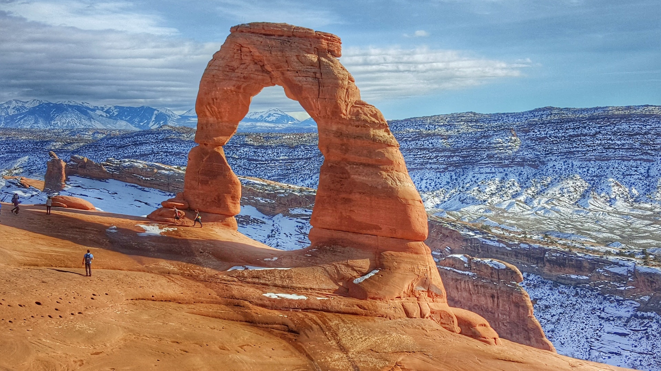
“The Beehive State’s most recent triumph? Sitting atop the Best States rankings from U.S. News – for the third year in a row.”
U.S. News and World Report
May 6, 2025
20

Slide 21
Budget Process/Policy
Part 6

Slide 22
HB 15 Medicaid Amendments
If the Medicaid expansion FMAP rate falls below 90%:
  Sunsets Medicaid expansion on the day after the Legislature adjourns from general session after the rate falls
  Requires DHHS to end certain programs that would lead to a reduction in federal matching funds for Medicaid expansion
  Requires DHHS to create a proposal to maintain Medicaid expansion within projected funding

Slide 23
HB 20 Correctional Facility Capacity
Creates the Corrections Facility Expansion Restricted Account
The account consists of money appropriated for new legislation impacting the Department of Corrections for:
  Any capital facilities costs
  One-time savings in the first or second year from delayed fiscal impacts of prison population increases
  Interest
Money in the account may be used for expanding or constructing state correctional facilities

Slide 24
HB 249 Federal Funds Modifications
Directs LFA to submit to the Federalism Commission the portions of each budget stress test related to federal funds
Requires the commission to review, and allows it to make recommendations, regarding those federal funds
Requires Utah State University to develop a data visualization of the state’s federal funds and model economic scenarios to inform federal funds contingency planning

Slide 25
HB 318 Agency Fee Amendments
Requires ISF and fee agencies to report rate and fee information to GOPB and LFA, before and after implementation:
  Amount of the rate/fee
  Estimated total annual revenue
  The account into which revenue will go
  Estimated quantity
  Estimated costs related to the rate/fee
  Whether the rate/fee is intended to cover all costs and why/why not
  For changed rates/fees, the % change and reasons
  Market analysis for ISF rate changes

Slide 26
HB 342 Federal Grant Process
Increases the approval thresholds for new federal funds requests
  Low: $0-$5M; Medium: $5-$25M; High: $25M-$100M; Ultra High: 100M+
For ultra high-dollar federal funds requests, requires the agency to submit the request to EAC before requesting from the federal government, and to the full Legislature within 120 days
Requires the President and Speaker to establish a legislative oversight committee for each approved ultra high-dollar request

Slide 27
HB 513 Attorney General Funding
Beginning FY 2028, requires the AG to bill agencies based on actual time spent and established rates
Requires the AG and each agency to annually agree on a legal services retainer, include it in the governor’s budget, and formalize expectations through a service-level agreement after legislative appropriation
Creates the Legal Services Retainer Fund, into which agencies transfer their retainers and from which the AG is paid for legal services
Requires agencies to use their own budget to pay for any services that exceed the agency’s balance in the Retainer Fund
Creates the Legal Services and Litigation Program to defend the state

Slide 28
HB 545 Budgetary Modifications
Repeals certain accounts/funds
Renames or adjusts certain accounts/funds
For a direct award grant, prohibits use of grant funds to administer the program unless approved in intent language
Modifies reporting requirements of competitive grants
Clarifies the authority of the State Auditor
Amends administration of the Industrial Assistance Account
Creates the Energy Development Infrastructure (Loan) Fund

Slide 29
SB 151 Public Safety Funding
Allows Transportation Investment Fund money to be used for operations and enforcement on state highways built with TIF funding

Slide 30
SB 216 Higher Ed Perf & Enroll Funding
Revises higher education performance funding by updating performance metrics and goals to reflect workforce outcomes and institutional missions
Establishes a new enrollment‑based funding model that ties funding to instructional cost levels across degree‑granting institutions and technical colleges
Sets transition and sunset provisions for implementing the updated funding framework

Slide 31
SB 229 State Employee Benefits
Establishes a paid time off (PTO) program to replace annual and sick leave for new state employees or current employees who choose to participate
Changes the 401(k) match available to PTO participating employees by changing the match rate (100% for first $26 and 50% for any amount above $26) and increasing the maximum employer contribution (2% of salary)
Requires each agency to establish a leave bank program

Slide 32
SB 288 Medicaid Provider Amendments
Directs DHHS to establish and apply performance measures to evaluate Medicaid providers
Requires implementation of a closed‑loop referral system to better coordinate health‑related social needs care for Medicaid‑eligible individuals
Appropriates funding to increase targeted Medicaid provider reimbursement rates

Slide 33
Questions?

